Slide 1
Supplementary Figures
Supplementary Figure 1 | QQ plot for main EWAS
Supplementary Figure 2 | QQ plot for phenotype*sex interaction analysis

Slide 2
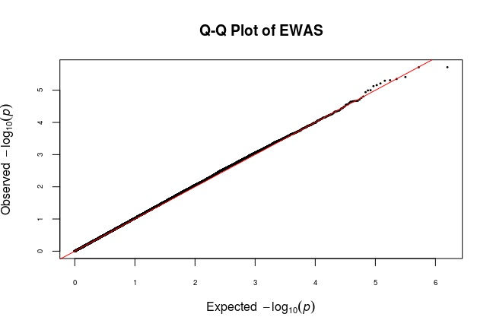
QQ plot for Main EWAS
λ = 1.09
Supplementary Figure 1: Quantile-quantile plot showing the empirically observed quantiles of p values for main AD+P/AD-P EWAS as compared to expected p-values.

Slide 3
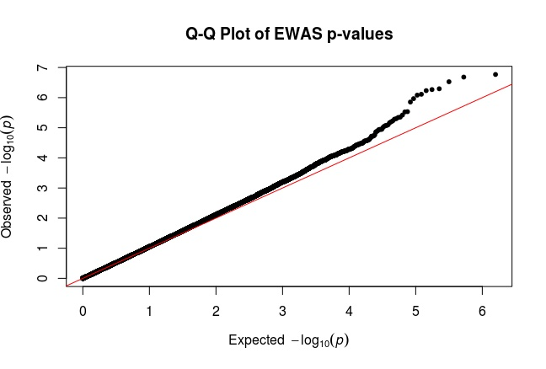
QQ plot for Phenotype*Sex Interaction Analysis
λ = 1.06
Supplementary Figure 2: Quantile-quantile plot showing the empirically observed quantiles of phenotype*sex interaction study p-values as compared to expected p-values.

